Slide 1
1
Indexing

Slide 2

The Concept of Index
2
Searching a Book…
Index
A data structure that helps us find data quickly
Note
Can be a separate structure (we may call it the index file) or in the records themselves.
Usually sorted on some attribute
Where are books by Rui ?
Index by
Author
Database
by Rao
Database
by Rui
Programming
by Alistair
Index by
Title
Where is “Database” ?
Catalogs
Books
Notes:
2

Slide 3
Query
3
Queries
Exact match (point query)
Q1: Find me the book with the name “Database”
Range query
Q2: Find me the books published between year 2003-2005
Searching methods
Sequential scan － too expensive
Through index – if records are sorted on some attribute, we may do a binary search
If sorted on “book name”, then we can do binary search for Q1
If sorted on “year published”, then we can do binary search for Q2
Notes:
3

Slide 4
Indexing
Indexing mechanisms used to speed up access to desired data.
E.g., author catalog in library
Search Key - attribute to set of attributes used to look up records in a file.
An index file consists of records (called index entries) of the form
Index files are typically much smaller than the original file
Two basic kinds of indices:
Ordered indices: search keys are stored in order
Hash indices: search keys are distributed uniformly across “buckets” using a “hash function”.
search-key
pointer
Notes:
4

Slide 5
Factors to evaluate indexes
Access Types: This refers to the type of access such as value based search, range access, etc.
Access Time: It refers to the time needed to find particular data element or set of elements.
Insertion Time: It refers to the time taken to find the appropriate space and insert a new data.
Deletion Time: Time taken to find an item and delete it as well as update the index structure.
Space Overhead: It refers to the additional space required by the index

Slide 6
Basic Concepts (Cont.)
Primary index: in a sequentially ordered file, the index whose search key specifies the sequential order of the file.
Also called clustering index
The search key of a primary index is usually but not necessarily the primary key.
Secondary index: an index whose search key specifies an order different from the sequential order of the file. Also called non-clustering index.
Index-sequential file: sequentially ordered file with a primary index.
Notes:
6

Slide 7
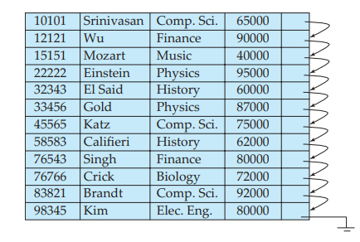
Sequential File For Instructor Records
Notes:
7

Slide 8
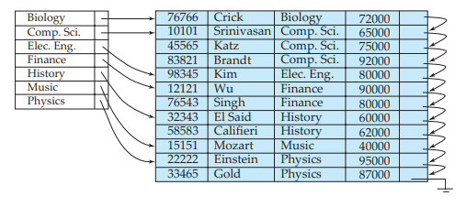
Dense index with search key dept name
In a dense clustering index, the index record contains the search-key value and a pointer to the first data record with that search-key value.
The rest of the records with the same search-key value would be stored sequentially after the first record, since, because the index is a clustering one, records are sorted on the same search key.
In a dense nonclustering index, the index must store a list of pointers to all records with the same search-key value.

Slide 9
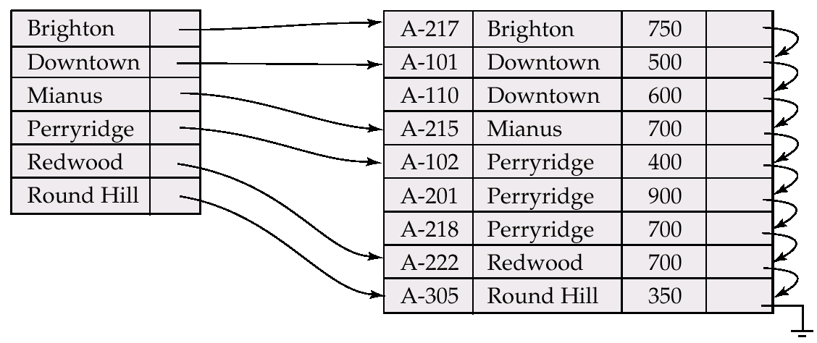
Dense Index Files
Dense index — Index record appears for every search-key value in the file.
Dense Index can be built on order as well as unordered fields of the database files.
Notes:
9

Slide 10
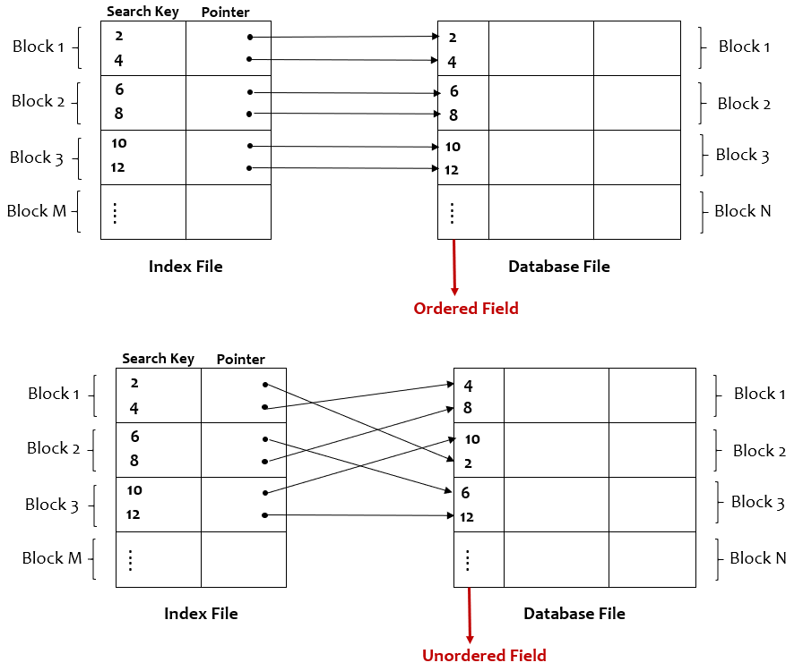

Slide 11
Sparse Index Files
Sparse Index: contains index records for only some search-key values.
To locate a record with search-key value K we:
Find index record with largest search-key value < K
Search file sequentially starting at the record to which the index record points
Less space and less maintenance overhead for insertions and deletions.
Generally slower than dense index for locating records.
Notes:
11

Slide 12
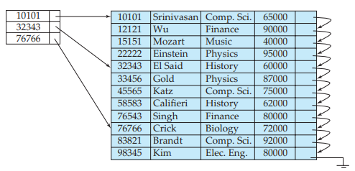
Sparse Index
Can sparse index be built when records are not sequentially ordered on search-key?
No Sparse indices can be used only if the relation is stored in sorted order of the search key, that is, if the index is a clustering index.

Slide 13
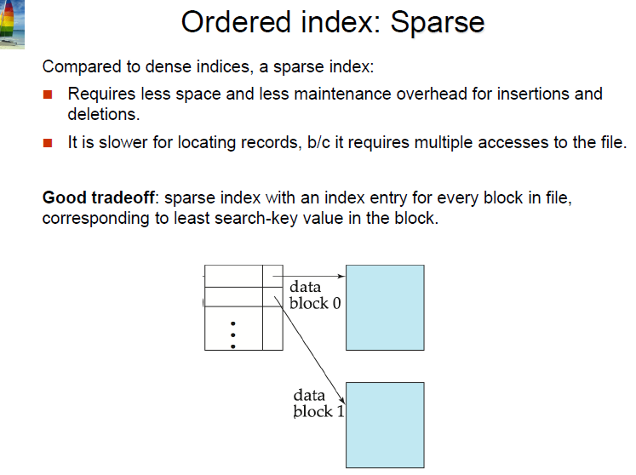

Slide 14
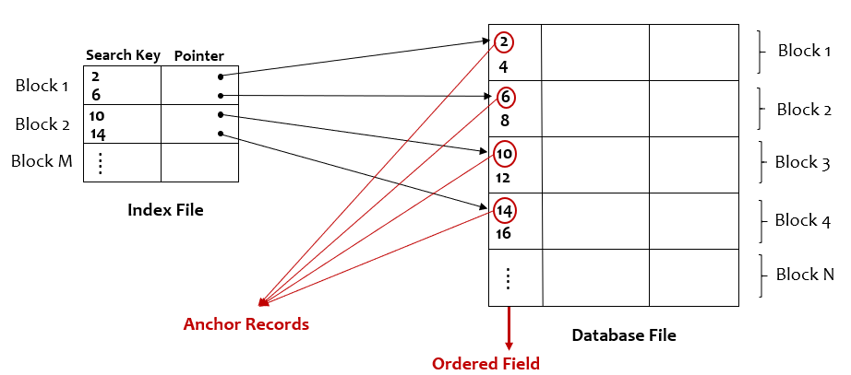

Slide 15
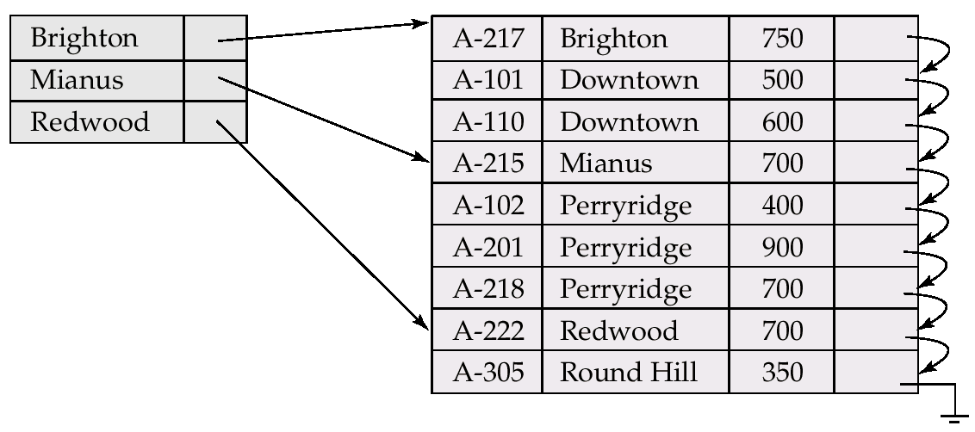
Example of Sparse Index Files
Notes:
15

Slide 16
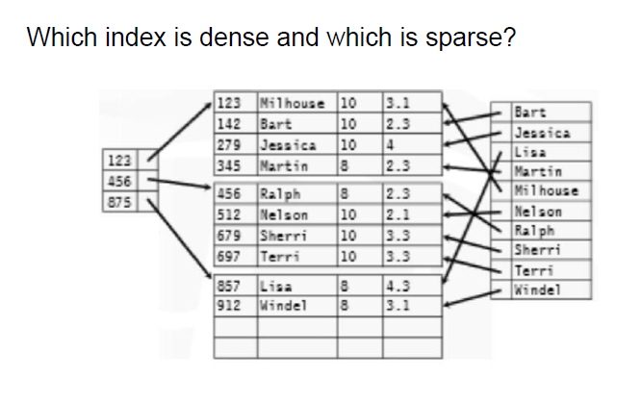

Slide 17
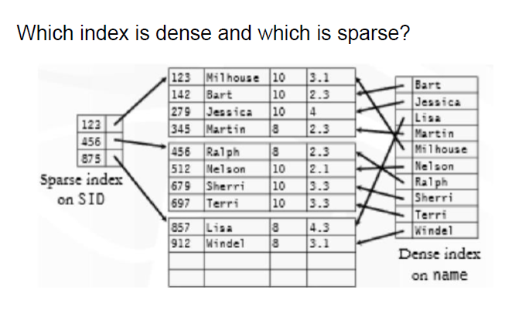

Slide 18
SQL
The command for creating an index is as follows:
CREATE INDEX index_name
ON table_name (column_1, column_2, ...);
CREATE TABLE Employee (
Employee_ID int PRIMARY KEY,
Name varchar(25) NOT NULL,
Age int NOT NULL,
Gender varchar(6) NOT NULL
);
Let’s create an index on the Employee_ID field (primary indexing).
CREATE INDEX index_id
On Employee (Employee_ID);
The command for dropping an index is as follows:
ALTER TABLE table_name
DROP INDEX index_name;

Slide 19
R(a,b,c,d)
Select a, b
From R
where c=1;
On which attribute(s) should we create index/indices on?
If there is a field that appears in the ‘where’ clause in multiple queries so we may consider creating an index on that attribute.
The list of attributes that are used in the select clause does not influence what attributes you should create indices on. (We have to look at the ‘WHERE’ clause).

Slide 20
Multilevel Index
If primary index does not fit in memory, access becomes expensive.
To reduce number of disk accesses to index records, treat primary index kept on disk as a sequential file and construct a sparse index on it.
outer index – a sparse index of primary index
inner index – the primary index file
If even outer index is too large to fit in main memory, yet another level of index can be created, and so on.
Indices at all levels must be updated on insertion or deletion from the file.
Notes:
20

Slide 21
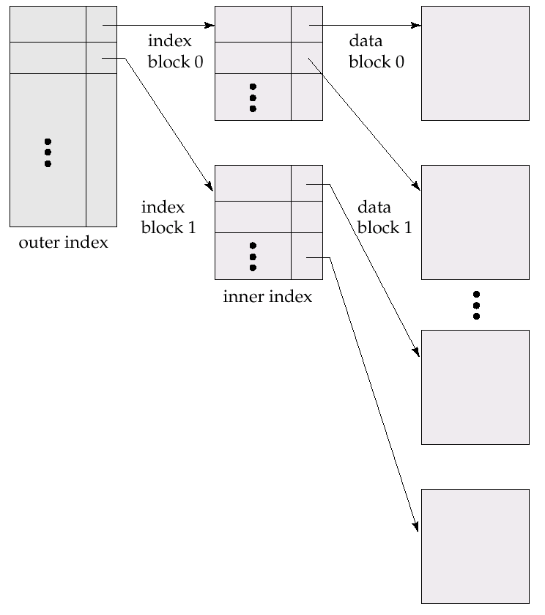
Multilevel Index (Cont.)
Notes:
21

Slide 22
Indexes on Composite Keys
22
Index on two or more attributes: entries are sorted first on the first attribute, then on the second attribute, the third …
Examples of composite key
indexes using lexicographic order (alphabetic order). E.g., for the case of two attributes (a1,a2)<(b1,b2) if either a1<b1 or if a1=b1 then a2<b2
Note
Different indexes are useful for different queries such as
Q4: age=20 & sal>10
Q5: sal=10 & age>20
.
11,80
11
12,10
12
12,20
name
age
sal
12
13,75
bob
12
10
13
<age, sal>
cal
11
80
<age>
joe
12
20
10,12
sue
13
75
10
20,12
Data records
sorted by name
20
75,13
75
80,11
80
<sal, age>
<sal>
Notes:
22

Slide 23
Secondary Indices
Frequently, one wants to find all the records whose values in a certain field (which is not the search-key of the primary index satisfy some condition.
Example 1: In the account database stored sequentially by account number, we may want to find all accounts in a particular branch
Example 2: as above, but where we want to find all accounts with a specified balance or range of balances
We can have a secondary index with an index record for each search-key value; index record points to a bucket that contains pointers to all the actual records with that particular search-key value.
Notes:
23

Slide 24
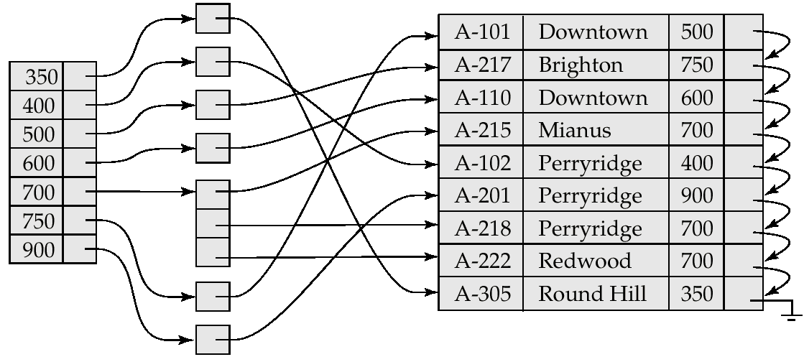
Secondary Index on balance field of account
Notes:
24

Slide 25
Types of Indexing (Summary)
Primary Index
Cluster Index
Secondary Index
 | Key | Non- Key
Ordered File | Primary index | Cluster Index
Unordered File | Secondary Index | Secondary Index

Slide 26
Search Without Index (End Note)
Consider a Hard Disk in which Block Size =1000 Bytes, each record is of size =250 Bytes. If total no. of records are 10000 and the data entered in Hard Disk without any order (unordered) then what is avg. time complexity to search a record from HD ?
HD
1000 Bytes
RAM
If ordered recored are there then time complexity log₂N = log₂ 2500 = 12
CPU
Number of records we can put in every block = 1000 B /250 B = 4 records
Number of blocks required 10000 records = 10000 /4 = 2500 Blocks
I/O cost (in transferring the blocks from HD to RAM ) =
Best case = 1, worst case = 2500, Avg. = 2500/2 = 1250
Linear search O(N) for unordered search

Slide 27
Primary Index
HD
Vina 20 Delhi Vikram 30 Nagpur Geeta 25 Jaipur Raghu 26 Agra
5 6 7 8
9 10 11
. .
Sparse
Pointer | Key (EmpID = Search Key)
 | 1 5 9
B1
Number of entries in the Index table = Number of blocks in the HD
B2
B3
Time Complexity log₂ N +1
N= Number of blocks in Index table
Index Table

Slide 28
Cluster Index
Sparse
DNO Name PAN (Non-Key)
Vina 41 1 Vikram 57 Geeta 23 Raghu 64
2 2 2 3
3 3 3 4
4 4
Pointer | Key (DNO = Search Key)
 | 1 2 3
 | 4
B1
Time Complexity log₂ N +1 +1
N= Number of blocks in Index table
B2
B3
Block Hanker
Index Table

Slide 29
Secondary Index for Key
Dense Index
EmpId Name PAN
Vina 41 Vikram 57 Geeta 23 Raghu 64
5 Yashi 24 6 Marry 74 7 Krish 42 8 Avi 82
9 10 11
. .
Key | Pointer
23 24 41 42 | . . . .
57 64 74 82 | . . . .
Key | Pointer
1 5 9
B1
Number of records in Index = Number of Records in HD
B2
Time Complexity log₂ N +1
B3
Primary Index Table
Secondary Index Table

Slide 30
Secondary Index for Non-key (two levels)
Search Key =Name
EmpId Name PAN
Vina 41 Vikram 57 Vina 23 Raghu 64
5 Vina 24 6 Marry 74 7 Krish 42 8 Vikram 82
9 10 11
. .
Dense Index
Key | Pointer
Krish Marry Raghu Vina Vikram | . . . .
 | . . . .
Key | Pointer
1 5 9
B1
B2
Time Complexity log₂ N +1 +1
B3
Primary Index Table
Intermediate layer (Block of record pointers)
Secondary Index Table

Slide 31
Search with Index (End Note)
Consider a Hard Disk in which Block Size =1000 Bytes, each record is of size =250 Bytes. If total no. of records are 10000 and the data entered in Hard Disk without any order (unordered) then what is avg. time complexity to search a record from Index Table if Index table entry is of 20B (Key + Pointer) ?
Key Pointer
HD
1000 Bytes (Block Size)
1000 Bytes (Block Size)
RAM
CPU
In case of sparse total blocks required are = 2500 /50 = 50 blocks
Each blocks in Index Table contains = 1000 B /20 B = 50 Records
Index Table
No. of searches required = log₂ 50 = 6 +1=7(total cost )
Dense = one entry for one record
Sparse Index = one entry for one block (anchor record)
In case of dense total blocks required are = 10000 /50 = 200 blocks
No. of searches required = log₂ 200 = 8 +1= 9 (total cost )

Slide 32
T/F?
SQL Indexing Decrease performance in INSERT, DELETE, and UPDATE query.
True: A general rule of thumb is that the more indexes you have on a table, the slower INSERT, UPDATE, and DELETE operations will be. This is why adding indexes for performance is a trade off, and must be balanced properly.

Slide 33
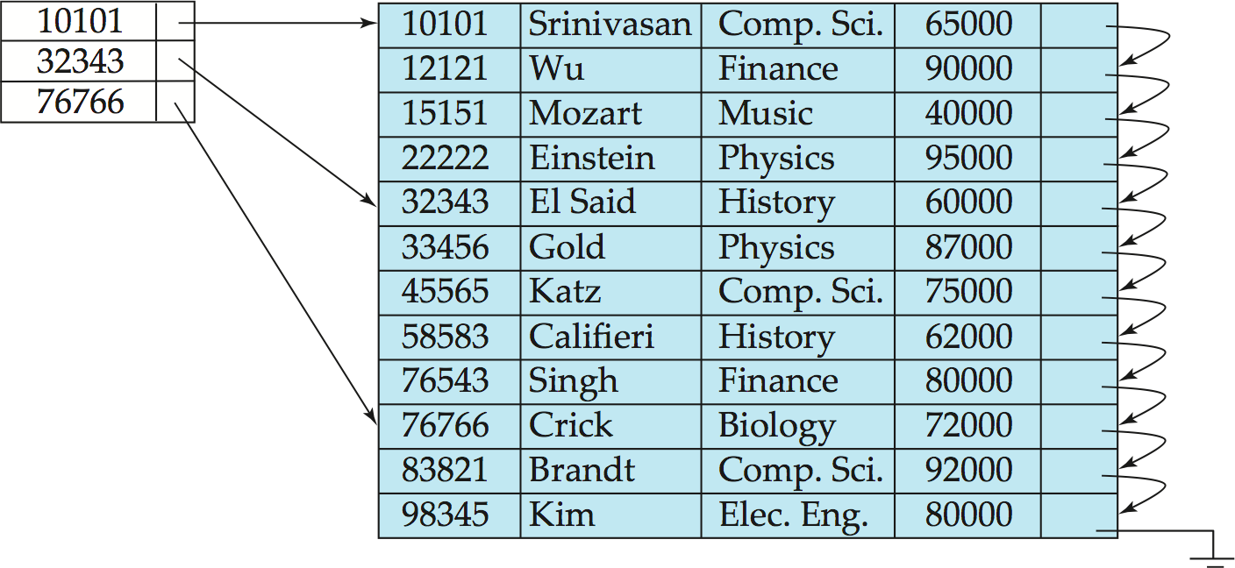
Index Update: Deletion
If deleted record was the only record in the file with its particular search-key value, the search-key is deleted from the index also.
Single-level index entry deletion:
Dense indices – deletion of search-key is similar to file record deletion.
Sparse indices –
if an entry for the search key exists in the index, it is deleted by replacing the entry in the index with the next search-key value in the file (in search-key order).
If the next search-key value already has an index entry, the entry is deleted instead of being replaced.

Slide 34
Index Update: Insertion
Single-level index insertion:
Perform a lookup using the search-key value appearing in the record to be inserted.
Dense indices – if the search-key value does not appear in the index, insert it.
Sparse indices – if index stores an entry for each block of the file, no change needs to be made to the index unless a new block is created.
If a new block is created, the first search-key value appearing in the new block is inserted into the index.
Multilevel insertion and deletion: algorithms are simple extensions of the single-level algorithms

Slide 35
B⁺-Tree Index Files
B⁺-tree indices are an alternative to indexed-sequential files.
Disadvantage of indexed-sequential files
performance degrades as file grows, since many overflow blocks get created.
Periodic reorganization of entire file is required.
Advantage of B⁺-tree index files:
automatically reorganizes itself with small, local, changes, in the face of insertions and deletions.
Reorganization of entire file is not required to maintain performance.
(Minor) disadvantage of B⁺-trees:
extra insertion and deletion overhead, space overhead.
Advantages of B⁺-trees outweigh disadvantages
B⁺-trees are used extensively

Slide 36
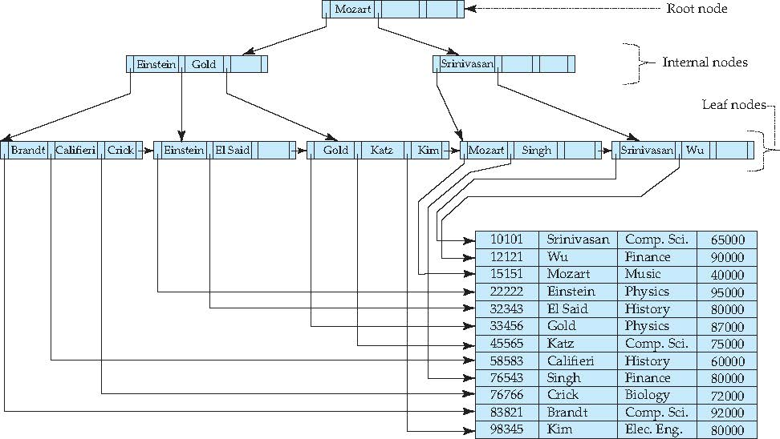
Example of B⁺-Tree

Slide 37
B⁺-Tree Index Files (Cont.)
A B⁺-tree is a rooted tree satisfying the following properties:
All paths from root to leaf are of the same length
Each node that is not a root or a leaf has between ⎡n/2⎤ and n children.
A leaf node has between ⎡(n–1)/2⎤ and n–1 values
Special cases:
If the root is not a leaf, it has at least 2 children.
If the root is a leaf (that is, there are no other nodes in the tree), it can have between 0 and (n–1) values.

Slide 38
B⁺-Tree Node Structure
Typical node
K_{i} are the search-key values
P_{i} are pointers to children (for non-leaf nodes) or pointers to records or buckets of records (for leaf nodes).
The search-keys in a node are ordered
K₁ < K₂ < K₃ < . . . < K_{n–1}
(Initially assume no duplicate keys, address duplicates later)

